Slide 1

Free Project - HoloTek
Louis VENTRE – {EPITECH.} 2019
Notes:
Hello,
My name is Louis. I’m a 5th year student in Computer Science at EPITECH

Slide 2
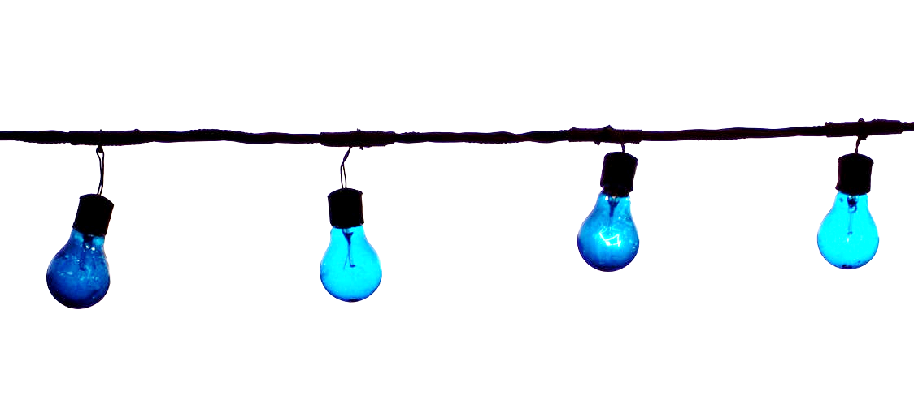
The Idea
Notes:
The main idea behind this project is to improve my knowledge in DirectX and UWP development, while creating something usefull at the same time
With this project, I aim to reduce the impact of two problems

Slide 3
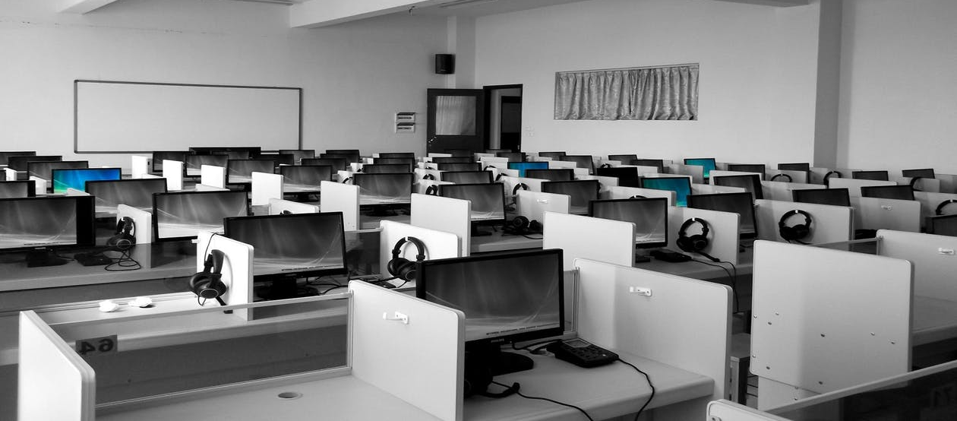
Student’s activities
Notes:
One for the professors
Right now presence of the students at activities is done by NFC using the eToken application.
It takes time, and if you’re not paying attention a student can use the NFC card of one of his colleague (an absent one…)

Slide 4
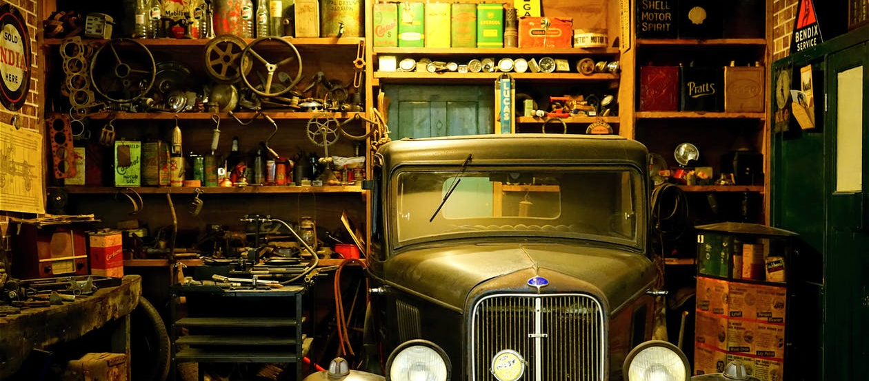
Hub projects
Notes:
One for the students and new comers (JPO)
Difficulties to understand what each hub project is, and how to interact with it

Slide 5
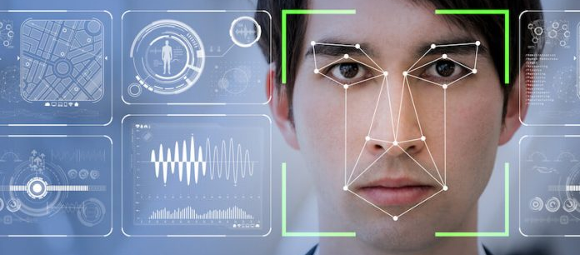
Object / Facial recognition
Notes:
To tacle this problem I’m gonna use facial and object recognition.

Slide 6
Presence of students
Notes:
Linked to the intranet, the application would be able to detect school students using this facial recognition technology. Multiple actions would then be possible. Marking their presence is one of the various possibilities.

Slide 7
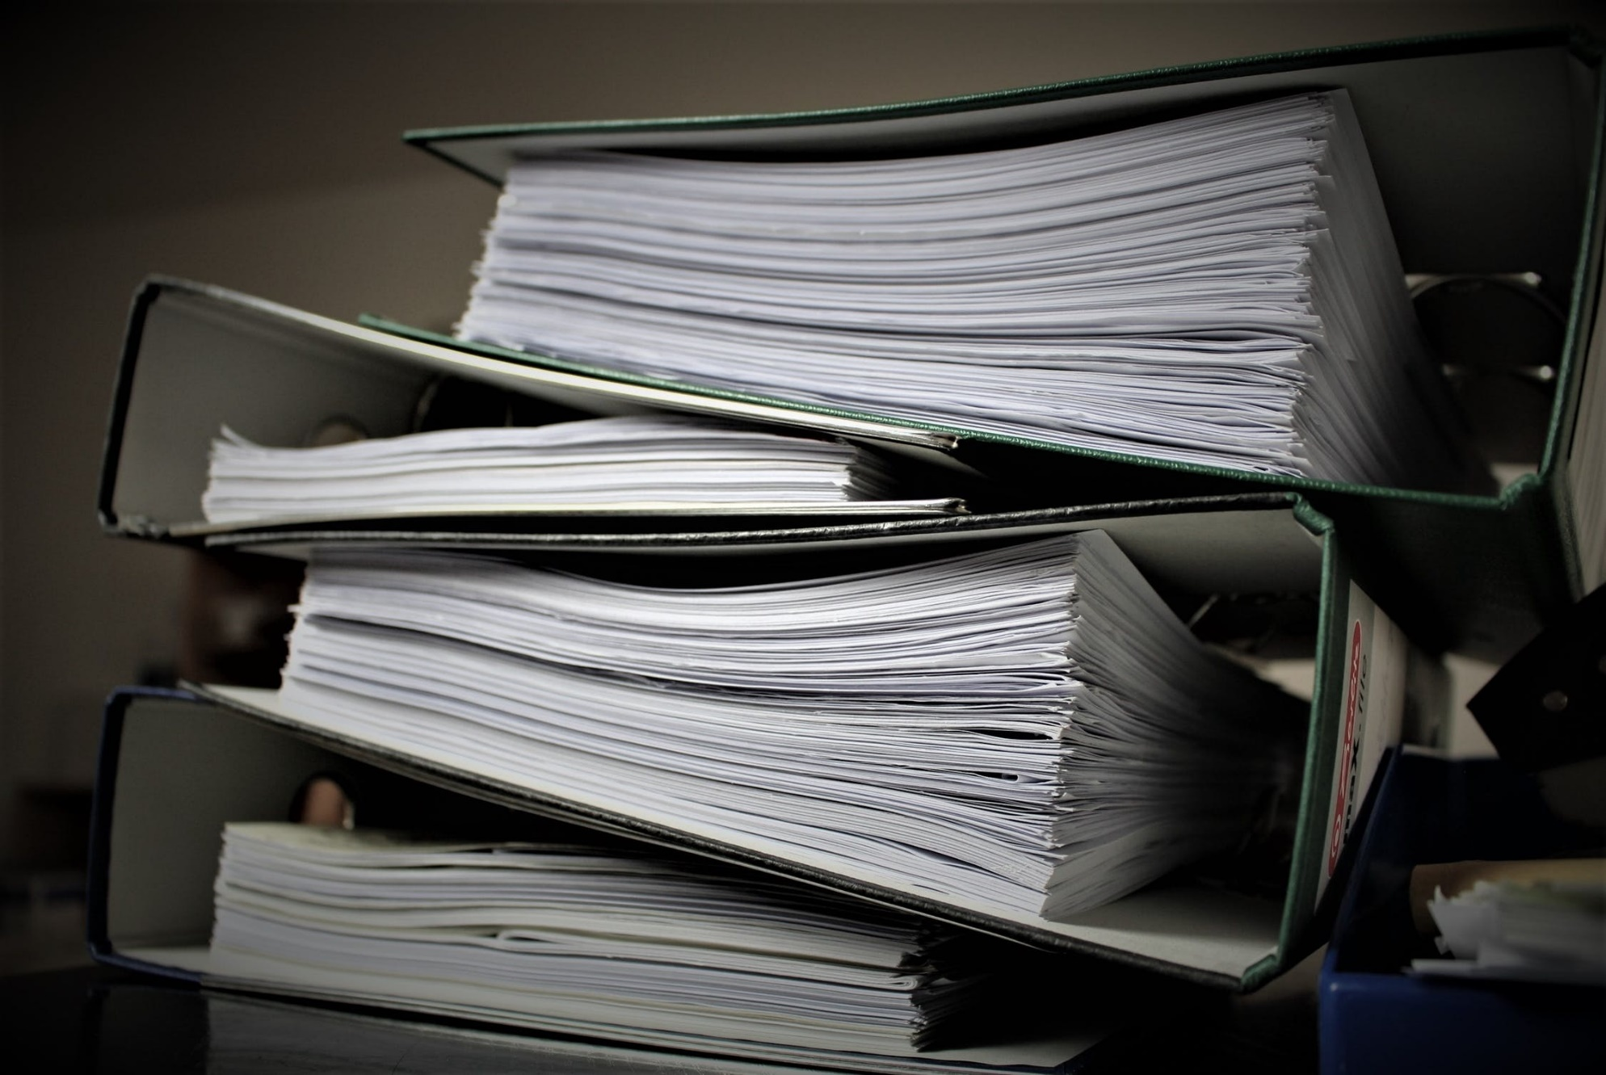
Student’s information
Notes:
Getting student informations would be another one: GPA, city, promotion, etc.

Slide 8
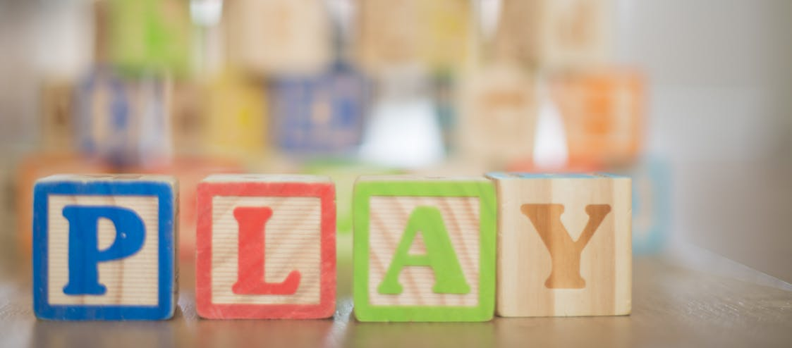
Fun stuff
Notes:
And some fun stuff like lying detector and physical information (hair color, etc.) would also be possible

Slide 9
Project’s information
Notes:
In case of the HUB projects you would be able to get informations about the project: creators, description, released date, etc.

Slide 10
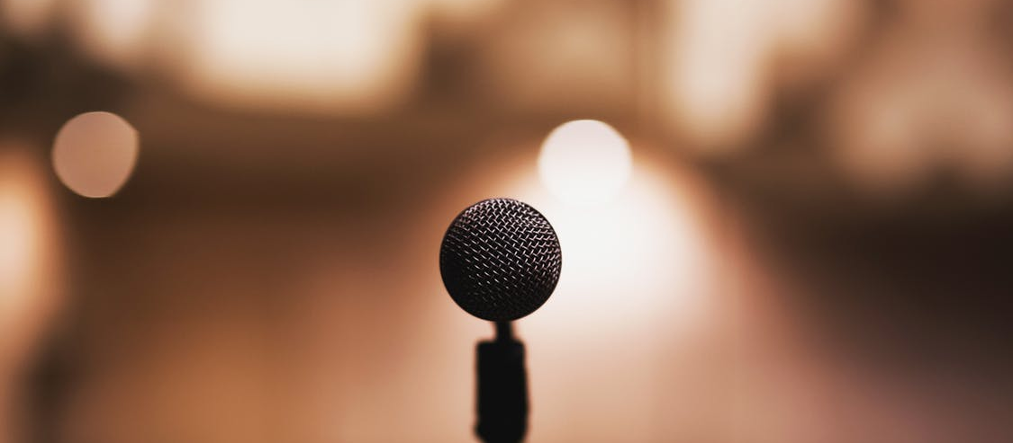
Interactions
Notes:
You will be able to interact with this projects, using speech recognition

Slide 11
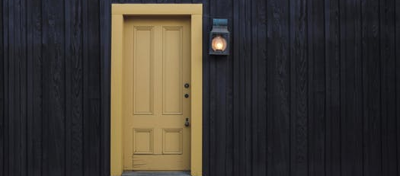
Example: Door project
Notes:
If we take a simple project as an example: a robot arm that open or close a door.
Using HoloTek you would be able to open the door only by looking at it and by saying « open ».

Slide 12
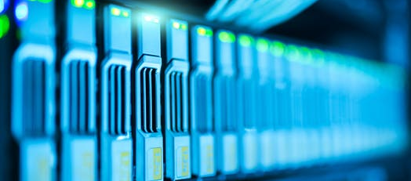
Web interface
Notes:
All this would be easily configurable using a web interface: adding new projects, new descriptions, new actions.

Slide 13
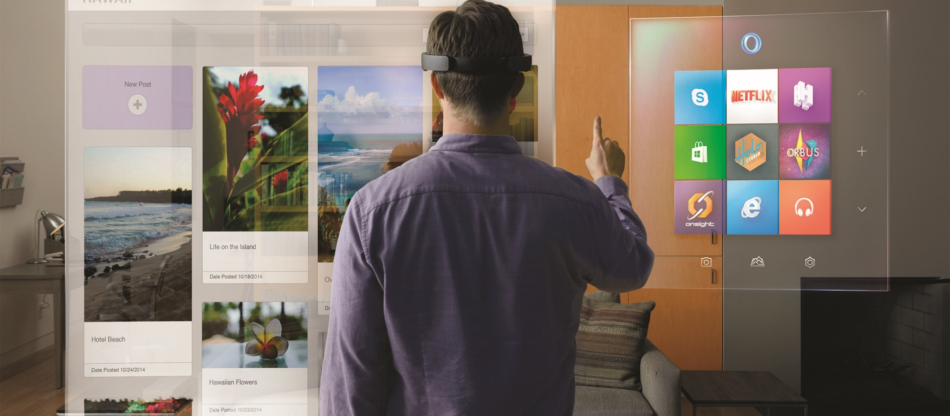
Mixed Reality
Notes:
The application would be released on the HoloLens

Slide 14




Technologies
Notes:
Using modern technologies
UWP Client HoloLens application: Dlib, C++, DirectX
Server and Web interface: GoLang. Container: Docker

Slide 15

From a blank page
Notes:
The aim is to do most of it by myself

Slide 16
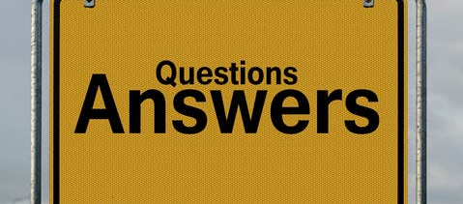
Questions ?

